Slide 1

SRS 2D PIC simulations
程先涛

Slide 2

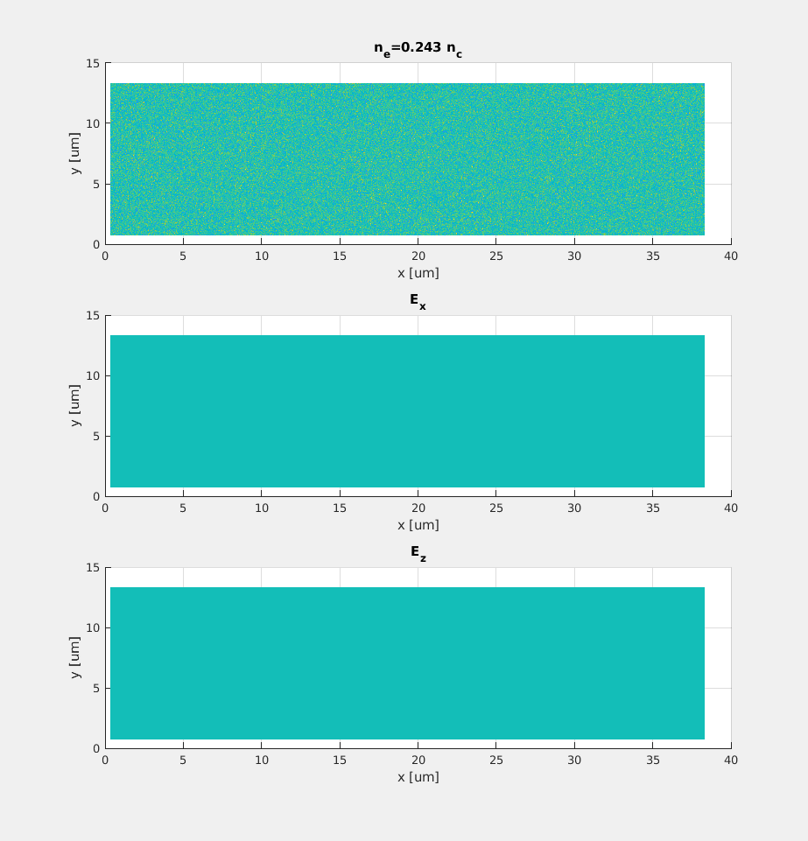

Animation of simulations
1

Slide 3
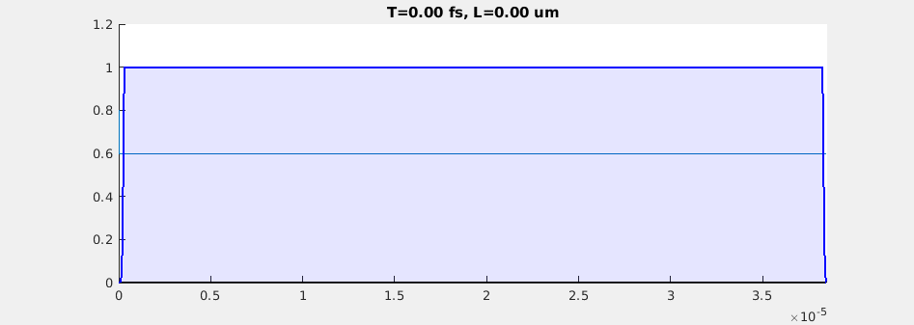
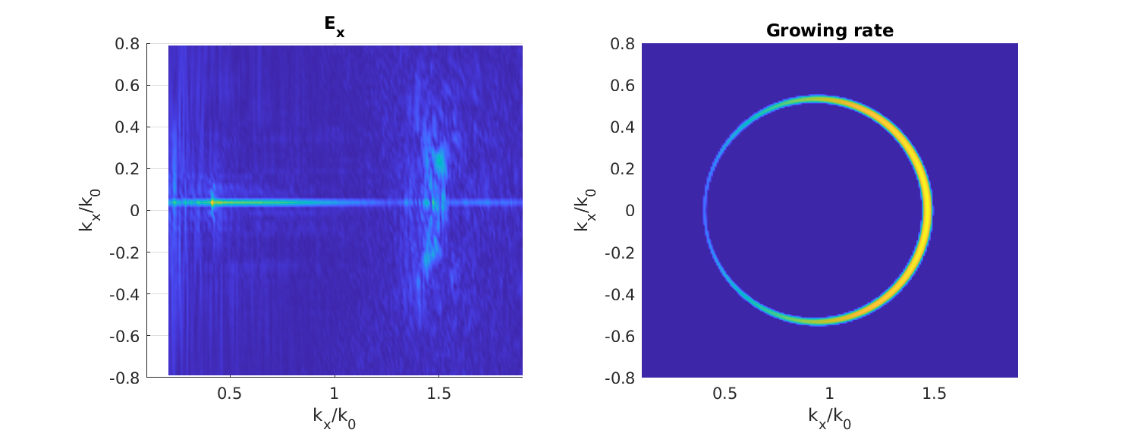
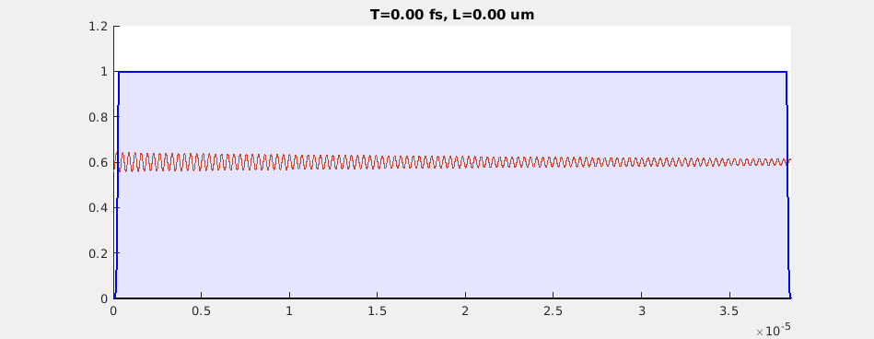
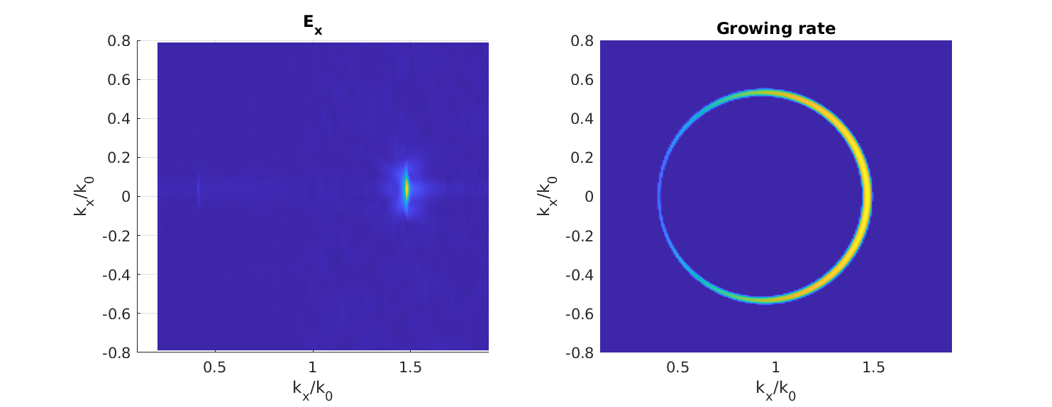
Effects of different laser shapes
2

Slide 4
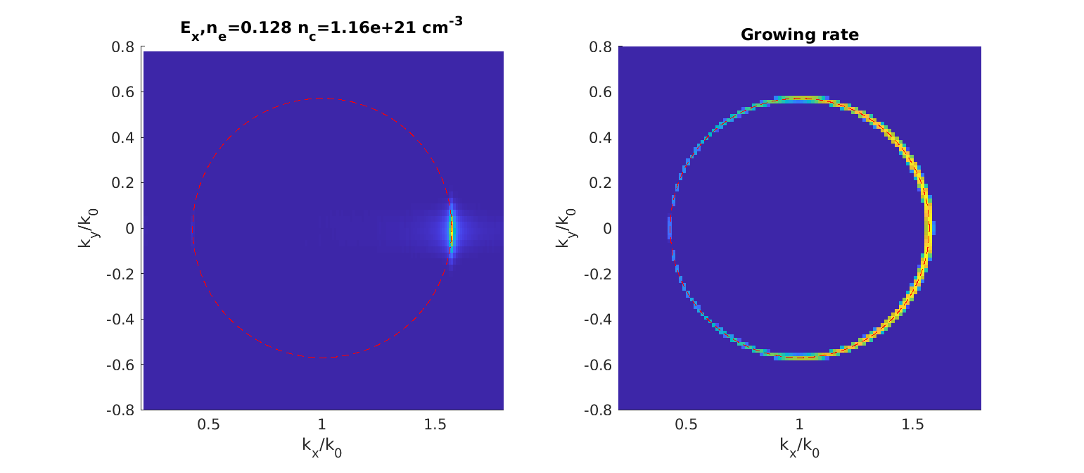
Parameter scan: plasma density
$$
\ a_0=0.014,\ \lambda=351\ nm,\ T=0\ keV
$$
3

Slide 5
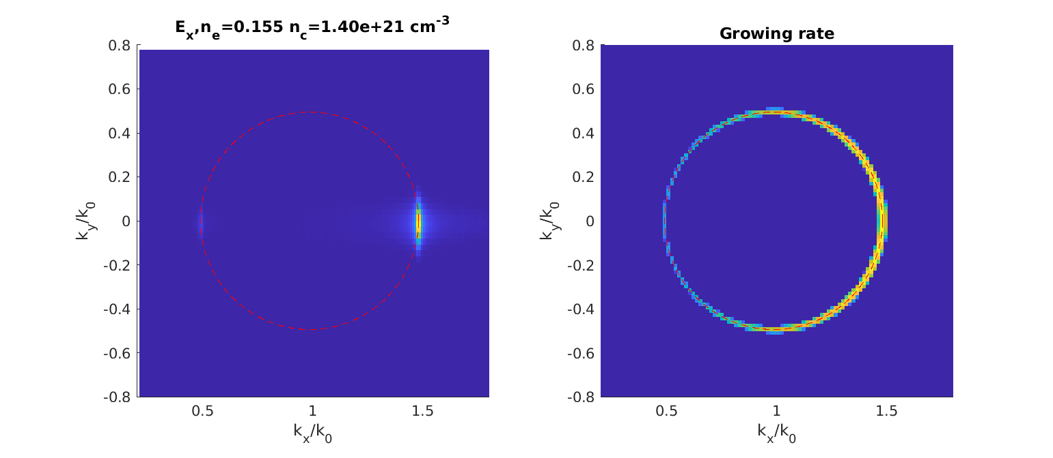
Parameter scan: plasma density
$$\ a_0=0.014,\ \lambda=351\ nm,\ T=0\ keV$$
4

Slide 6
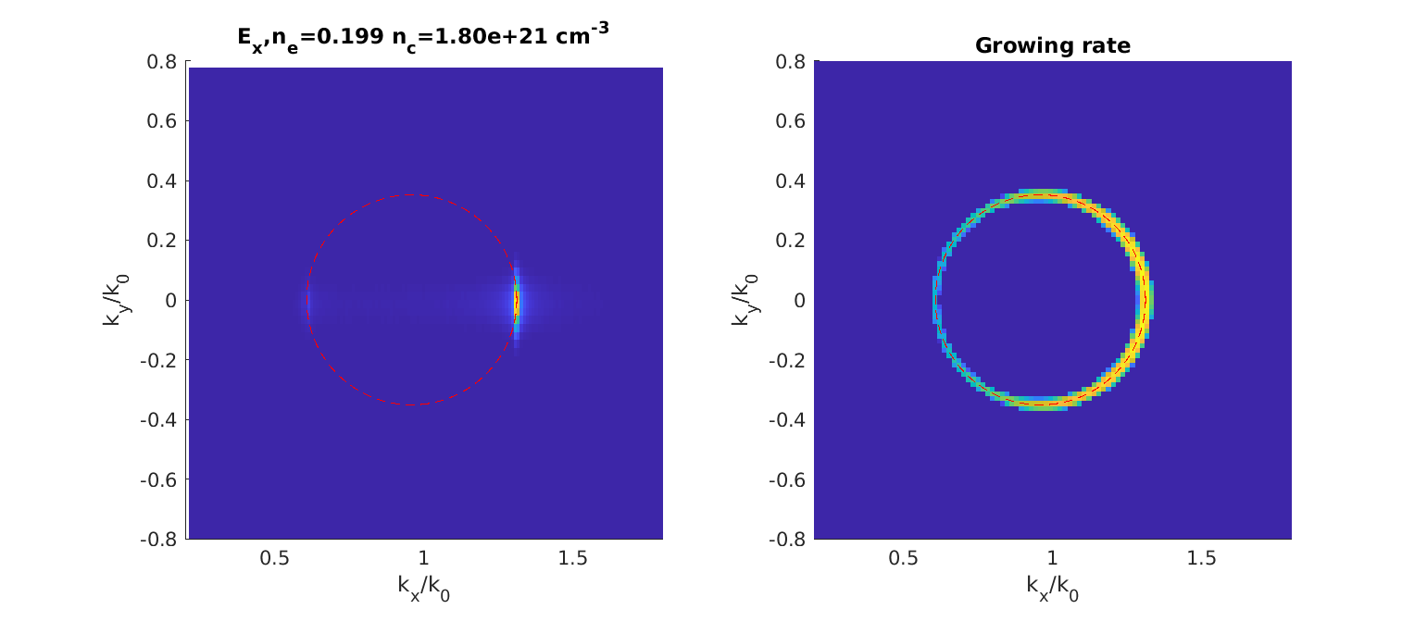
Parameter scan: plasma density
$$\ a_0=0.014,\ \lambda=351\ nm,\ T=0\ keV$$
5

Slide 7
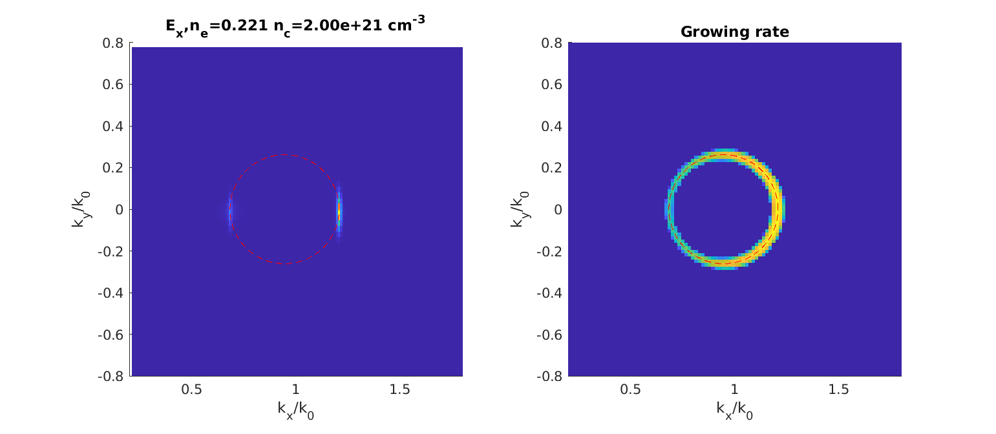
Parameter scan: plasma density
$$\ a_0=0.014,\ \lambda=351\ nm,\ T=0\ keV$$
6

Slide 8
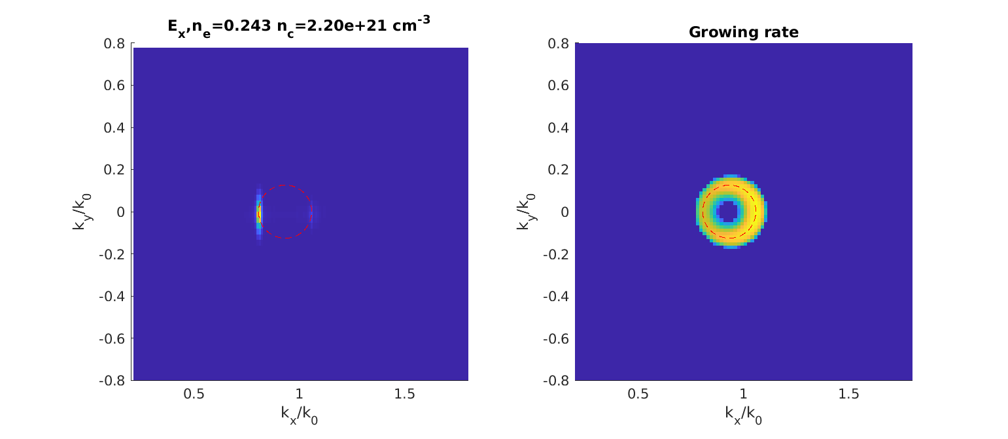
Parameter scan: plasma density
$$\ a_0=0.014,\ \lambda=351\ nm,\ T=0\ keV$$
7

Slide 9
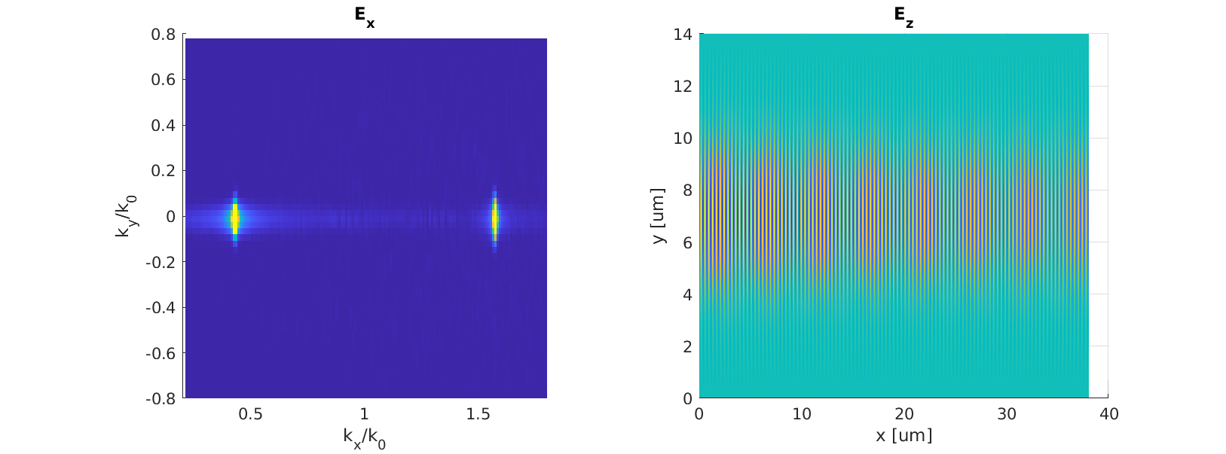
Parameter scan: laser waist
$$\ a_0=0.014,\ \lambda=351\ nm,\ n_e=\ 1.1583 imes 10^{21}\ cm^{-3}, T=0\ keV$$
8

Slide 10
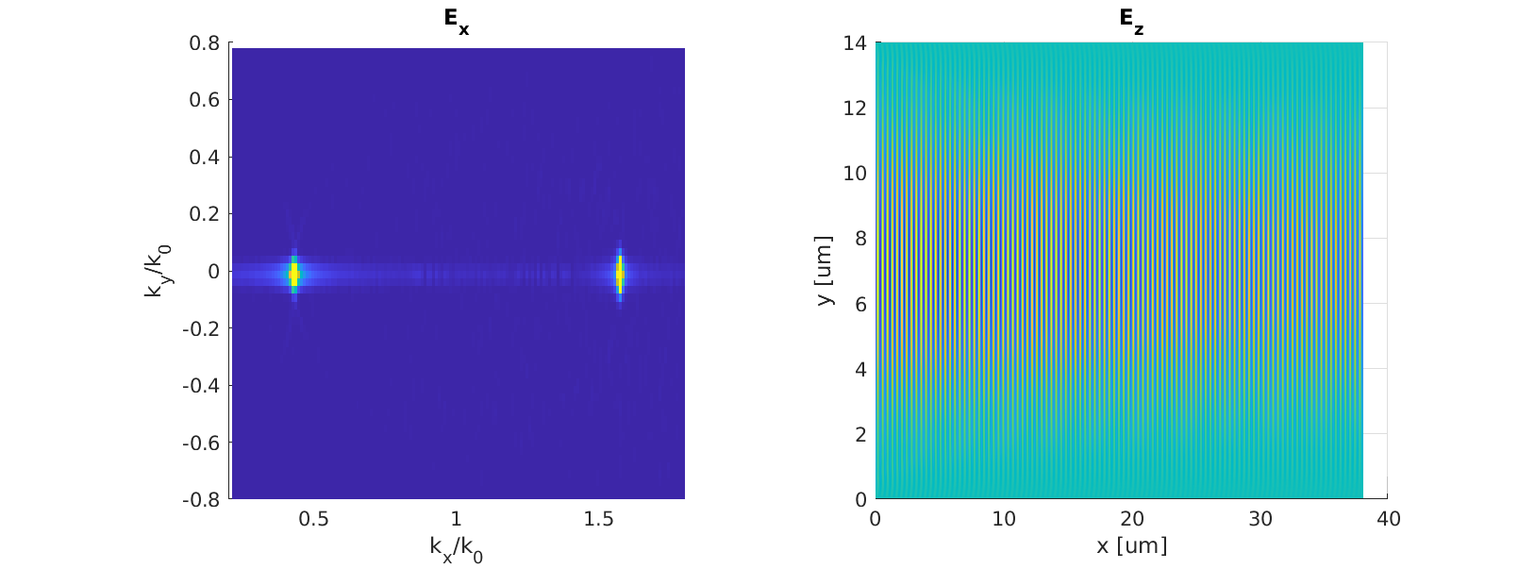
Parameter scan: laser waist
$$\ a_0=0.014,\ \lambda=351\ nm,\ n_e=\ 1.1583 imes 10^{21}\ cm^{-3}, T=0\ keV$$
9

Slide 11
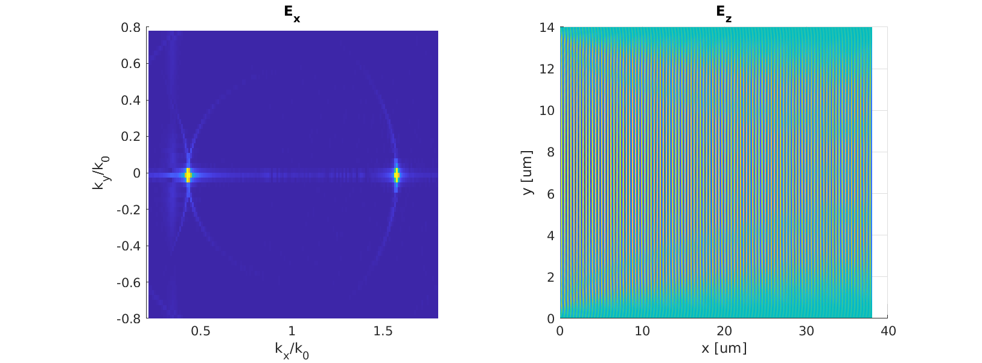
Parameter scan: laser waist
$$\ a_0=0.014,\ \lambda=351\ nm,\ n_e=\ 1.1583 imes 10^{21}\ cm^{-3}, T=0\ keV$$
10

Slide 12
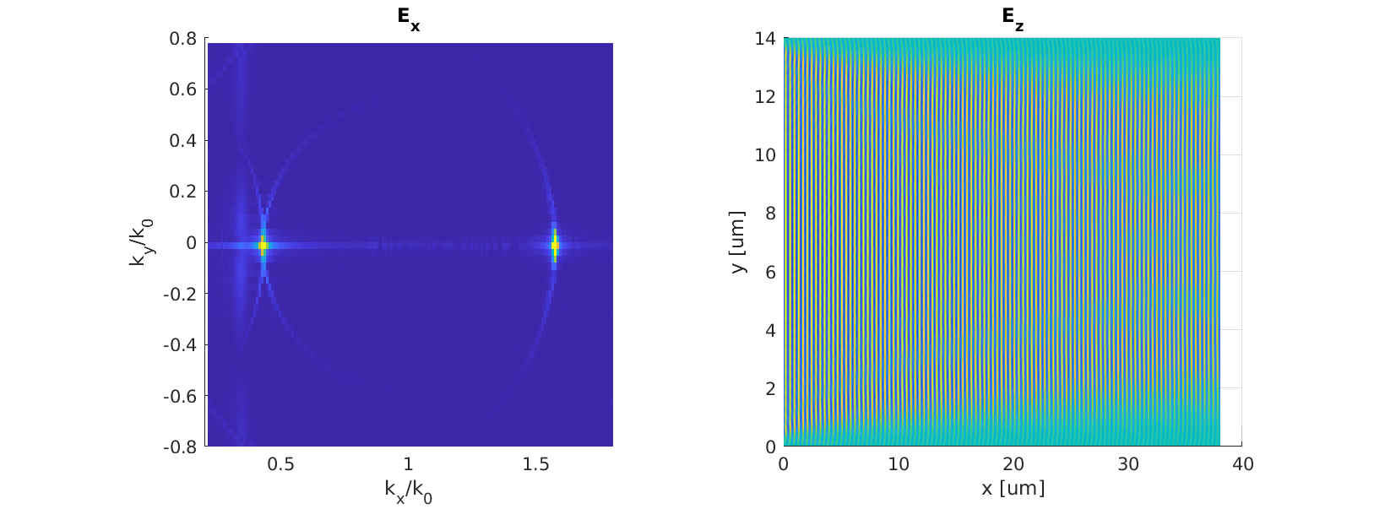
Parameter scan: laser waist
$$\ a_0=0.014,\ \lambda=351\ nm,\ n_e=\ 1.1583 imes 10^{21}\ cm^{-3}, T=0\ keV$$
11

Slide 13
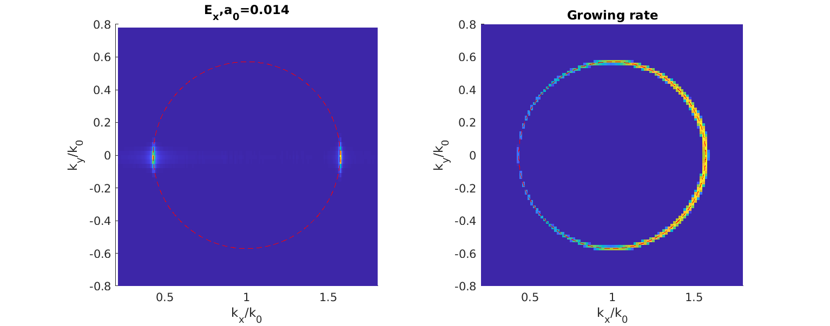
Parameter scan: laser a_0
$$\lambda=351\ nm,\ n_e=\ 1.1583 imes 10^{21}\ cm^{-3}, T=0\ keV$$
12

Slide 14
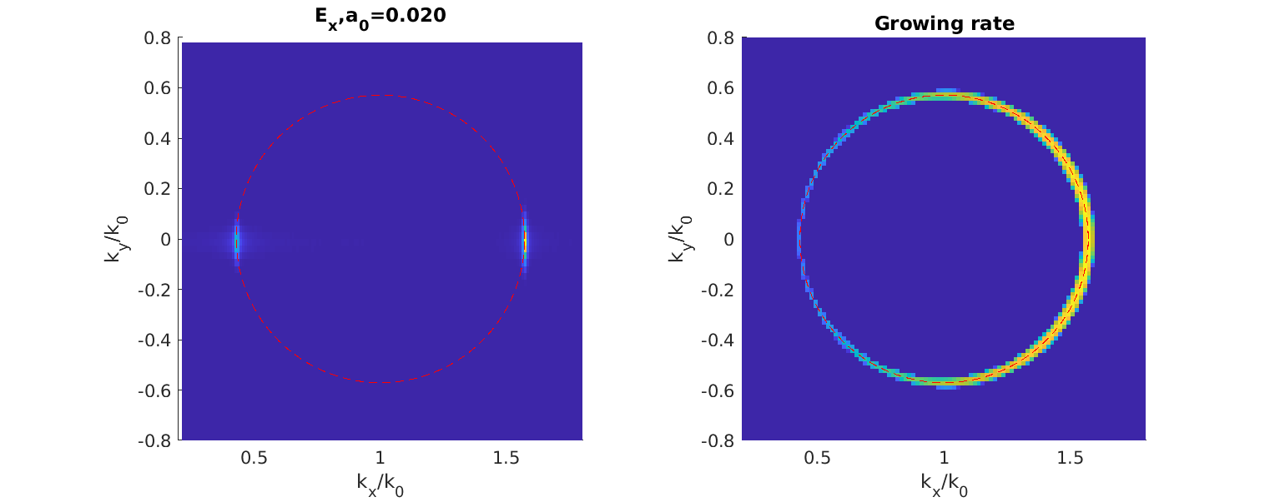
Parameter scan: laser a_0
$$\lambda=351\ nm,\ n_e=\ 1.1583 imes 10^{21}\ cm^{-3}, T=0\ keV$$
13

Slide 15
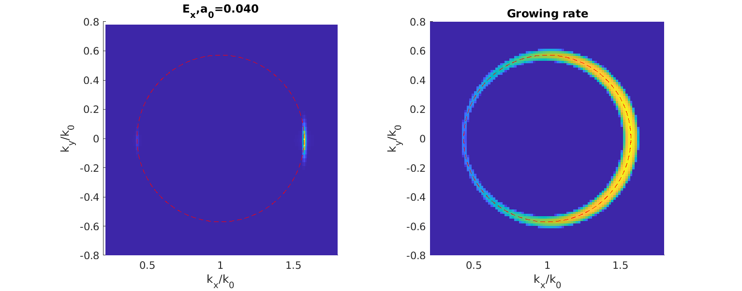
Parameter scan: laser a_0
$$\lambda=351\ nm,\ n_e=\ 1.1583 imes 10^{21}\ cm^{-3}, T=0\ keV$$
14

Slide 16
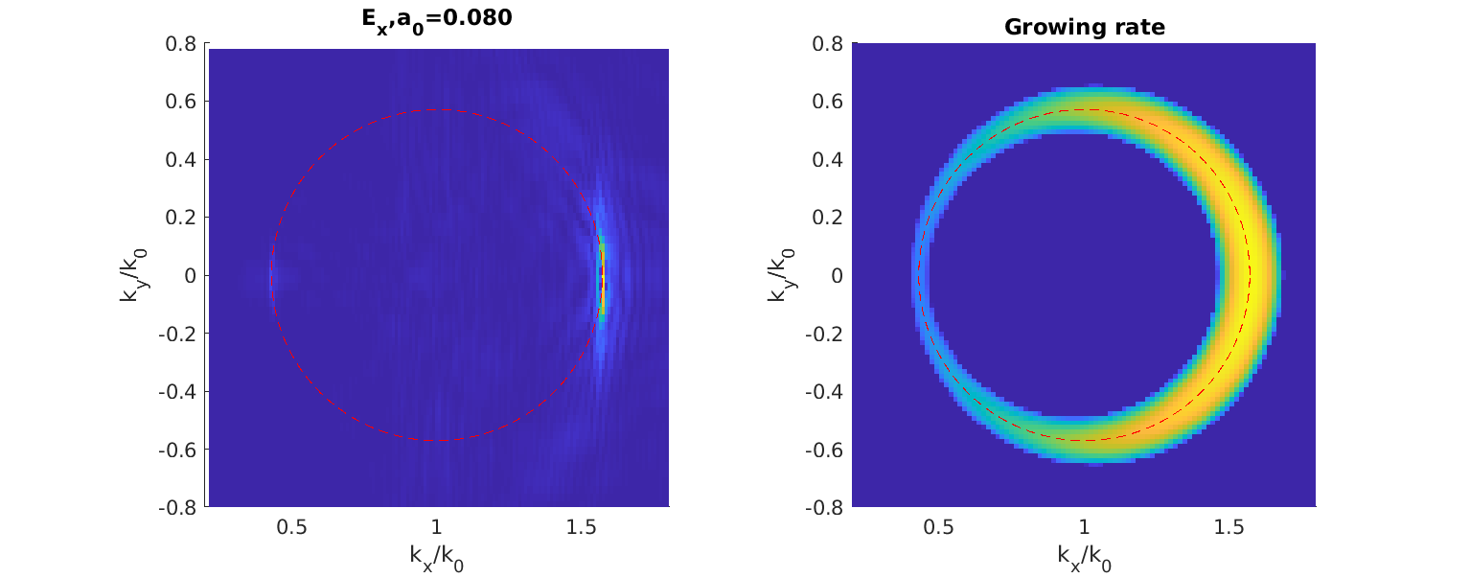
Parameter scan: laser a_0
$$\lambda=351\ nm,\ n_e=\ 1.1583 imes 10^{21}\ cm^{-3}, T=0\ keV$$
15

Slide 17
PIC simulation parameters
Software: PIConGPU(https://picongpu.readthedocs.io/en/latest)
Grid: 800 x 5500 (4,400,000)
Particles: 64 per cell
Time steps: 41,971 (980 fs)
Device: A100 x 1
Computation time: 30 min
16

Slide 18


